Slide 1
CMSC 304
Bindings & The Symbol Table
Claire Sparks

Slide 2
Opening Terminology
Structs:
  Like an object with all public variables, no methods, no static variables
  Structs have state but no behavior

Slide 3
Attributes and Binding
Identifiers (or names):
  Fundamental abstraction mechanism used to represent language entities or constructs
  Identifiers allow us to refer to variables, functions, types, etc. using symbolic names rather than low-level concepts like memory addresses
Attributes: properties that determine the meaning of the identifier to which they are bound
Binding: process of associating an attribute with a name

Slide 4
Attributes and Binding
Binding time:
  The time when an attribute is computed and bound to a name
Two categories of binding:
  Static binding: occurs prior to execution
  Dynamic binding: occurs during execution
Vast majority of bindings are static bindings
Only two attributes are dynamically bound
  The binding of identifiers to storage locations
  The binding of storage locations to values
All other attributes are statically bound
  (Edge cases almost certainly exist but that’s outside the scope of the course)

Slide 5
Attributes and Binding
Example in Java:
          public static double foobar(int n){
          …
          }
Attributes include:
  Number, names, and data types of parameters
  Return value data type
  Code body to be executed
All statically bound!

Slide 6
Attributes and Binding
Static binding: occurs prior to execution
Dynamic binding: occurs during execution
Examples– static or dynamic?
  int x;
  x = 2;
  const int n = 2;
  int y; y = 7;
Notes:
First static, second dynamic, third static, fourth is *both* cause it’s two statements lol
Third is static cause it’s a const

Slide 7
Attributes and Binding
Some attributes are bound prior to translation time
  Predefined identifiers: specified by the language definition
    i.e. maxint in java is specified by the language definition
Possible binding times for attribute names:
  Language definition time
  Language implementation time
  Translation time
  Link time
  Load time
  Execution time
All binding times except execution time are static binding
}
→
→
These are the individual components of compile time in the C programming language
Compile time

Slide 8
Declarations
Declarations are a principle method for establishing bindings
Bindings can be implicit or explicit
Example in C: int x;
  Data type is explicitly bound
  Value of x is implicitly bound
    Probably 0, but it’s implicit and can’t be assumed to be anything in particular
Example in C: int x = 0;
  Explicitly binds 0 as the initial value

Slide 9
Declarations
An entire declaration statement itself may be implicit in languages where simply using the variable name causes it to be declared
Sometimes a language will allow for declarations that bind certain attributes but not others
  Function prototype in C: double f(int x);
    Binds the parameters types, parameter names, and return type to identifier f
    Does not bind the function body to identifier f
Notes:
In C we say a function prototype is a forward declaration, *not* a definition. Because only some of the properties of a function are defined here. Why you’d want to do this will come up in the C unit, too much to worry about here

Slide 10
Scope and Blocks
Scope: textual region of the program in which a binding is active
In modern languages, the scope of a binding is determined statically
Block: body of a module, class, subroutine, or structured control-flow statement
  A block contains a sequence of statements surrounded by syntactic markers
  For example, C and Java use { } to indicate the start and end of blocks
  Python uses whitespace (indentation)
Local declarations: declarations associated with a block
Nonlocal declarations: declarations associated with surrounding blocks or global declarations

Slide 11
Scope and Blocks
Typically, the scope of a binding is the block in which the binding was established
A binding exists in the scope in which it's declared and in each internally nested scope
  Unless it’s hidden by another declaration with the same name in one or more nested scopes
If no binding is found at any scope level an error occurs
Many languages provide a collection of predefined objects / functions
  It is common to consider these to be declared in an extra, invisible, outermost scope, which surrounds the scope in which global objects are declared

Slide 12
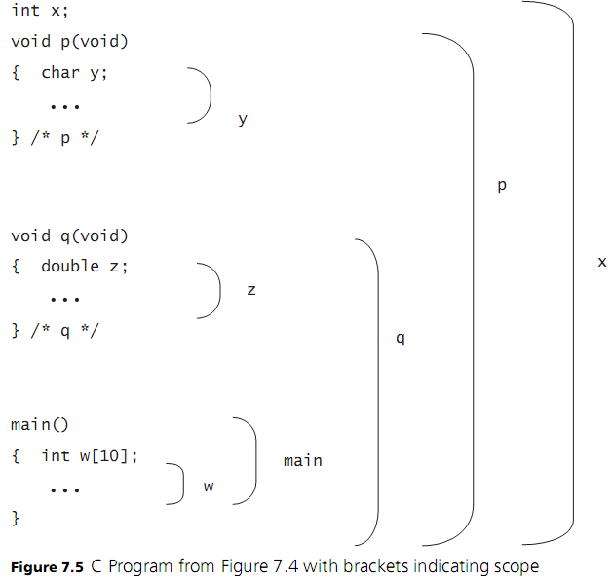


Slide 13
Scope and Blocks
Besides blocks, other sources of declarations include:
  A struct definition composed of local (member) declarations
  A class in object-oriented languages
Declarations can be collected into packages (Java, Ada), modules (Python), and namespaces (C++)

Slide 14
Scope Holes and Visibility
A declaration is hidden by another declaration of the same name in one or more nested scopes
A global variable is said to have a scope hole in a block containing a local declaration with the same name
  Use scope resolution operator :: in C++ to access the global variable
Local declaration is said to shadow its global declaration
Visibility: includes only regions where the bindings of a declaration apply
Notes:
Example on next slide

Slide 15
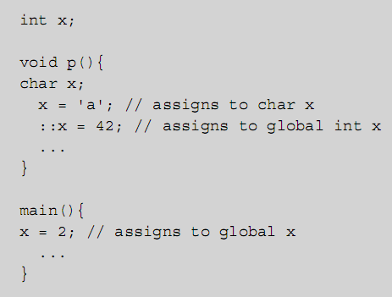
Scope Holes and Visibility

Slide 16
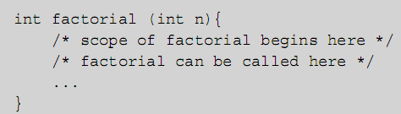
Nested Subroutines
Scope rules need to be constructed such that recursive declarations are possible when they make sense
  For example, subroutines must be allowed to be recursive, so a subroutines name must have scope beginning before the block of the subroutine body

Slide 17
Declaration Order
Can an expression X reference any name declared in the current scope, or only names declared before X in the scope?
To resolve this question, several early languages, including Algol 60 and Lisp, required that all declarations appear at the beginning of their scope
Modern languages implement declaration before use:
  Explicitly specifies the scope of a binding is the portion of that block from the declaration to the end
Forward reference: an attempt to use a name before its declaration
Java and C++ go even further, allowing constructs like classes and functions to be referenced before declaration!
Notes:
Classes and Functions need to be declared somewhere the compiler can see them for this to work. i.e. the compiler does two passes, the first to identify all the classes and functions, the second to do traditional analysis
Permitting forward references can greatly increase the complexity and memory requirements of a compiler, and generally prevents the compiler from being implemented in one pass.

Slide 18
The Symbol Table
Symbol table: a data structure that maintains all static bindings of attributes to identifiers
  The most basic operations are to insert a binding, remove a binding, or to look up the attributes already bound to a given identifier
    Can be thought of as a function that expresses the bindings of attributes to identifiers
  How exactly the symbol table is implemented isn’t important to us as different translators can have different approaches
A translator creates a symbol table to maintain static bindings
The symbol table is retained throughout translation then is discarded
  For complied languages, no symbol table information is needed at runtime
  Although it’s commonly saved for use by debuggers
Notes:
Symbol table is commonly implemented as a hash map

Slide 19
Static Scoping
Static scoping (or lexical scoping)
  The symbol table is managed by the compiler during compilation
  All maintained bindings must be static bindings
    Because the symbol table doesn’t exist at runtime!
  Program file is analyzed from top to bottom, line by line
    Runtime concepts like execution path have no effect on the symbol table
A statically scoped, block-structured language requires a stack-like data structure to perform scope analysis:
  On block entry, all declarations of that block are processed and bindings added to symbol table
  On block exit, bindings are removed, restoring any previous bindings that may have existed
Notes:
The scope rules we just laid out are implemented by the symbol table

Slide 20
A Statically Scoped Symbol Table
Attributes are properties that determine the meaning of the identifier to which they are bound
What specific properties are considered attributes?
  Is the size of an array an attribute?
  Depends on the specific language implementation
For all examples and assignments in this class, only two properties will be considered attributes:
  The data type of the identifier
    Or the return type if the identifier is a function
  The scope of the identifier
    Because all functions are global, function identifiers use the keyword “function”

Slide 21
A Statically Scoped Symbol Table
Values are never attributes and should never be included on the symbol table
  More on values next unit
This is very a simplified model
  Allows us to focus on the mechanics of symbol tables without being overwhelmed by language specific details
  Removes ambiguity from creating and analyzing symbol tables in the class
All real world symbol tables are more complex but operate using the same principles we discuss in lecture

Slide 22
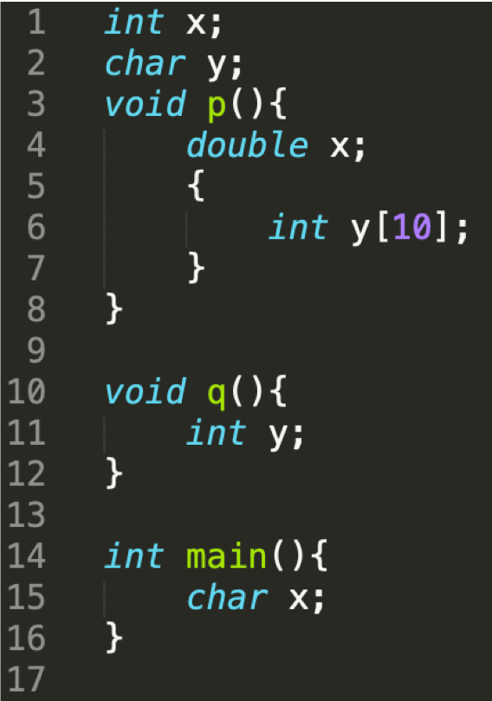
A Statically Scoped Symbol Table

Slide 23
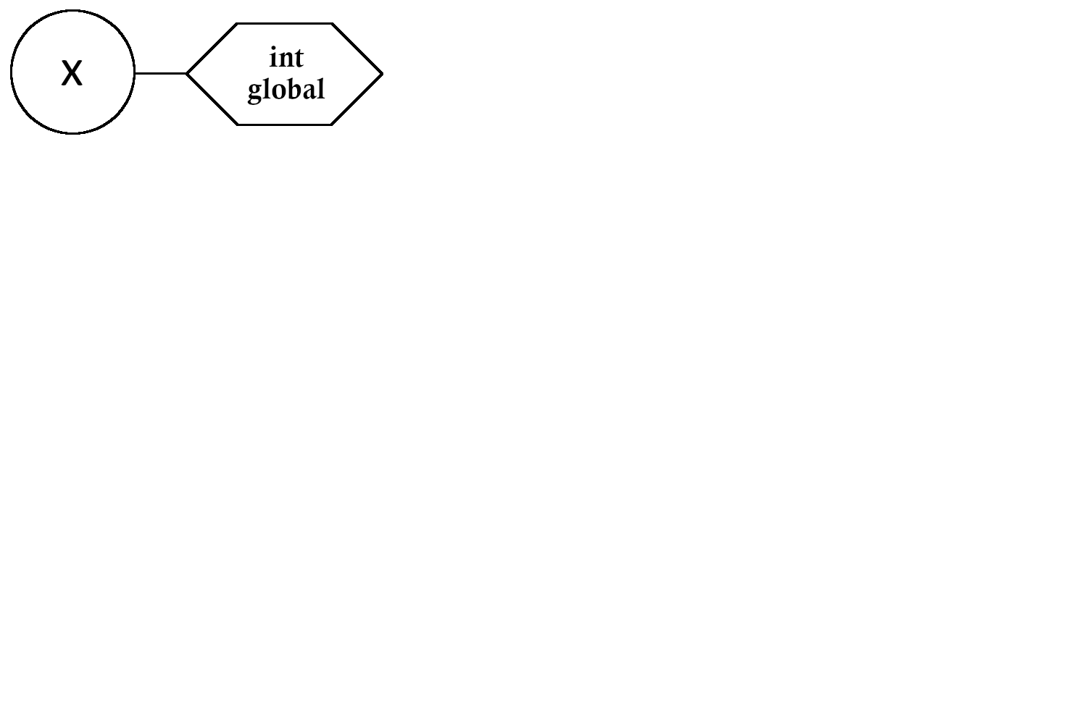
A Statically Scoped Symbol Table

Slide 24
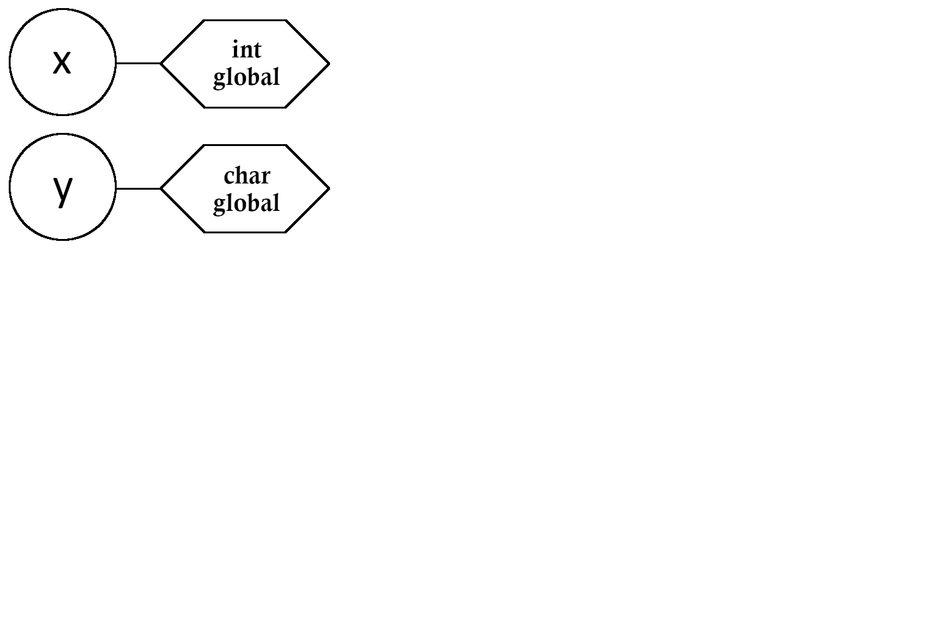
A Statically Scoped Symbol Table

Slide 25
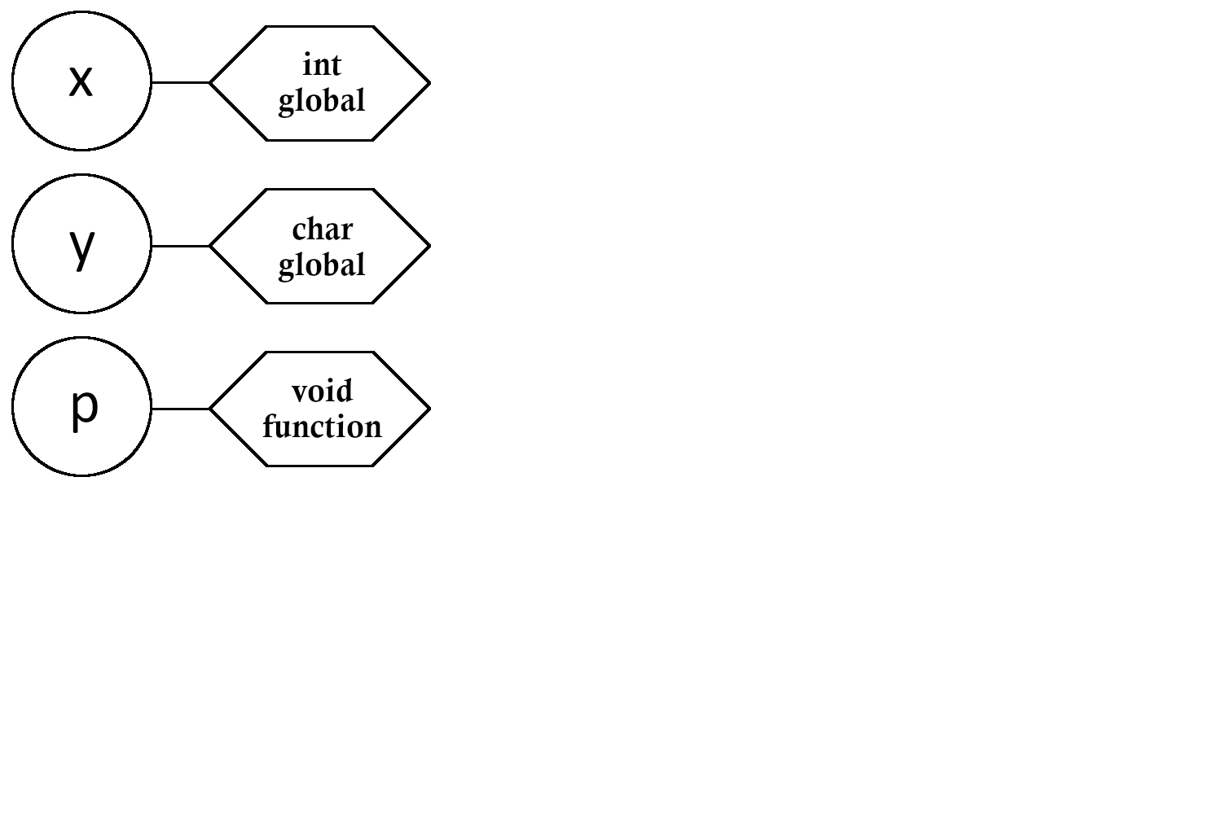
A Statically Scoped Symbol Table

Slide 26
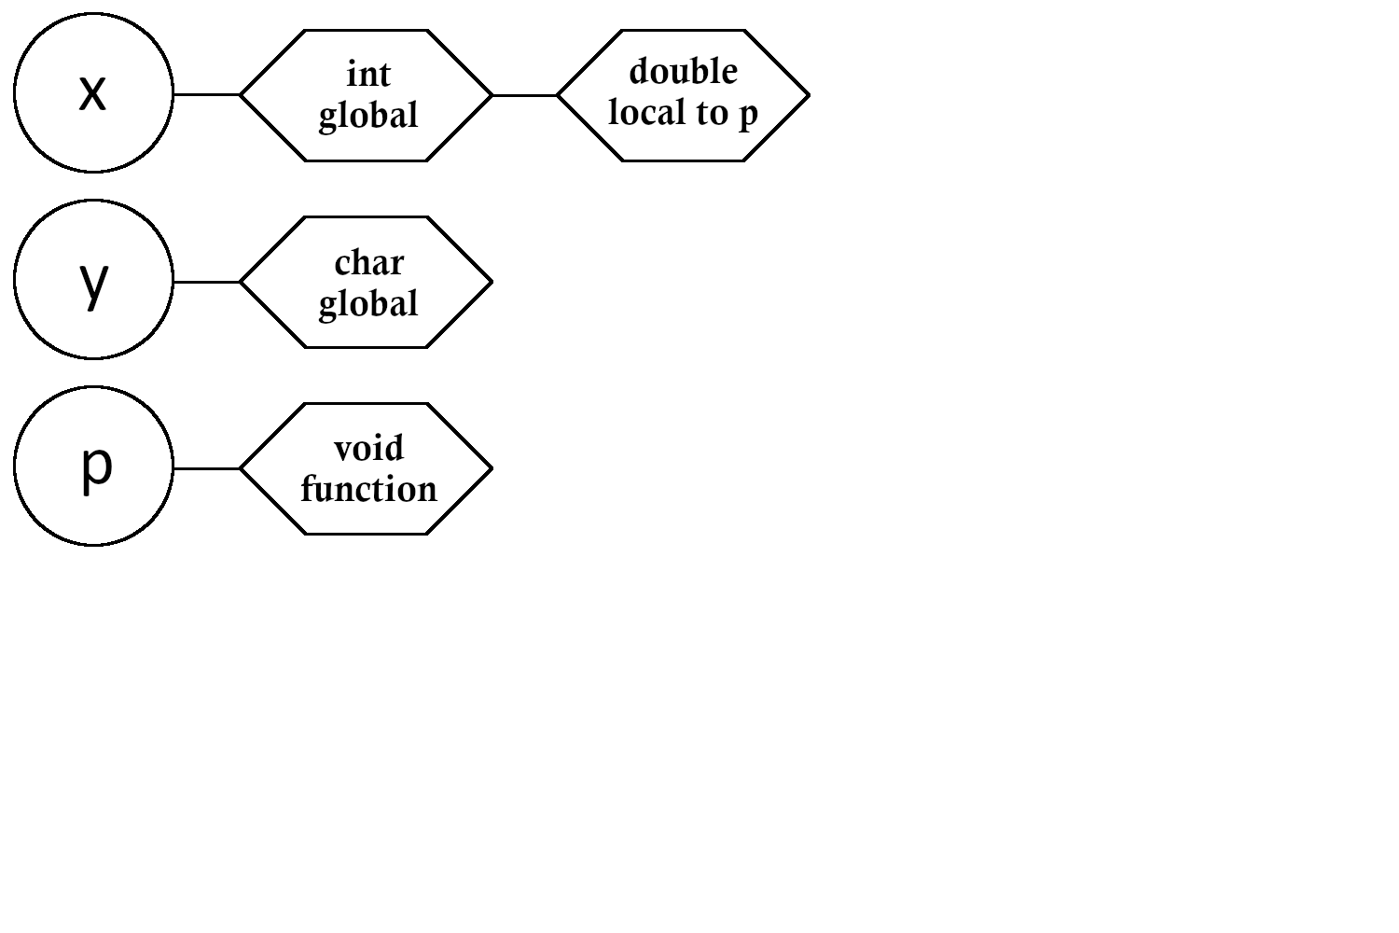
A Statically Scoped Symbol Table

Slide 27
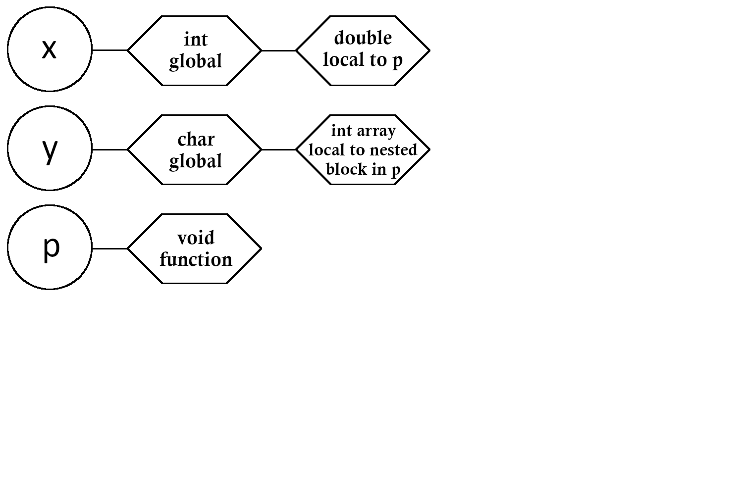
A Statically Scoped Symbol Table

Slide 28
A Statically Scoped Symbol Table

Slide 29
A Statically Scoped Symbol Table

Slide 30
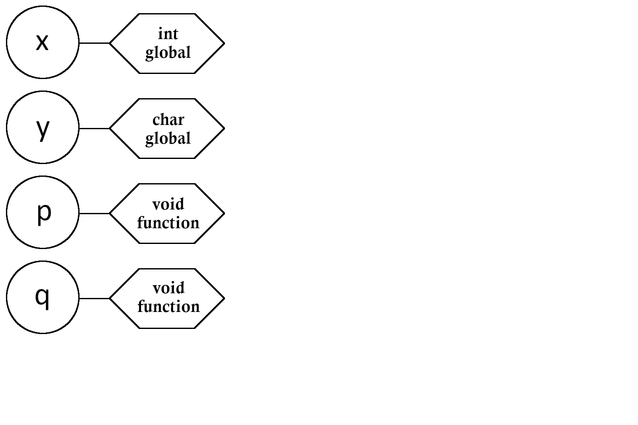
A Statically Scoped Symbol Table

Slide 31
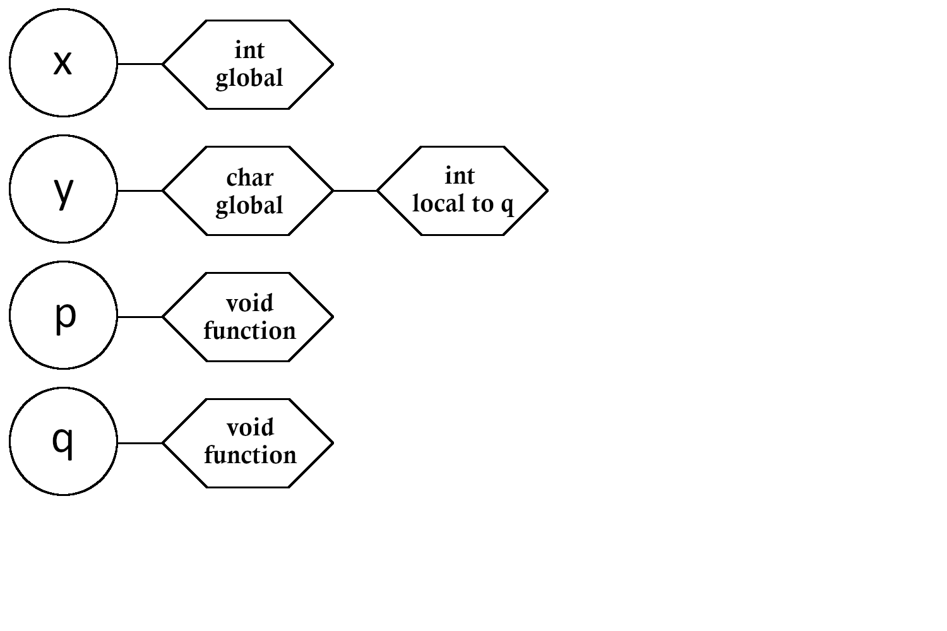
A Statically Scoped Symbol Table

Slide 32
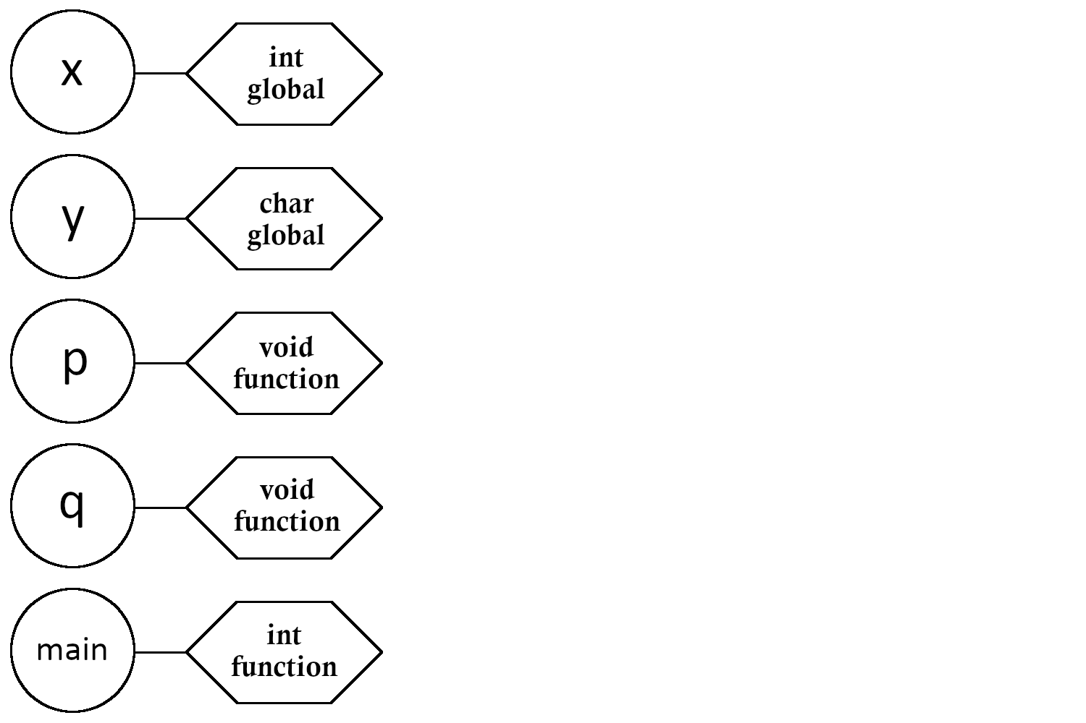
A Statically Scoped Symbol Table

Slide 33
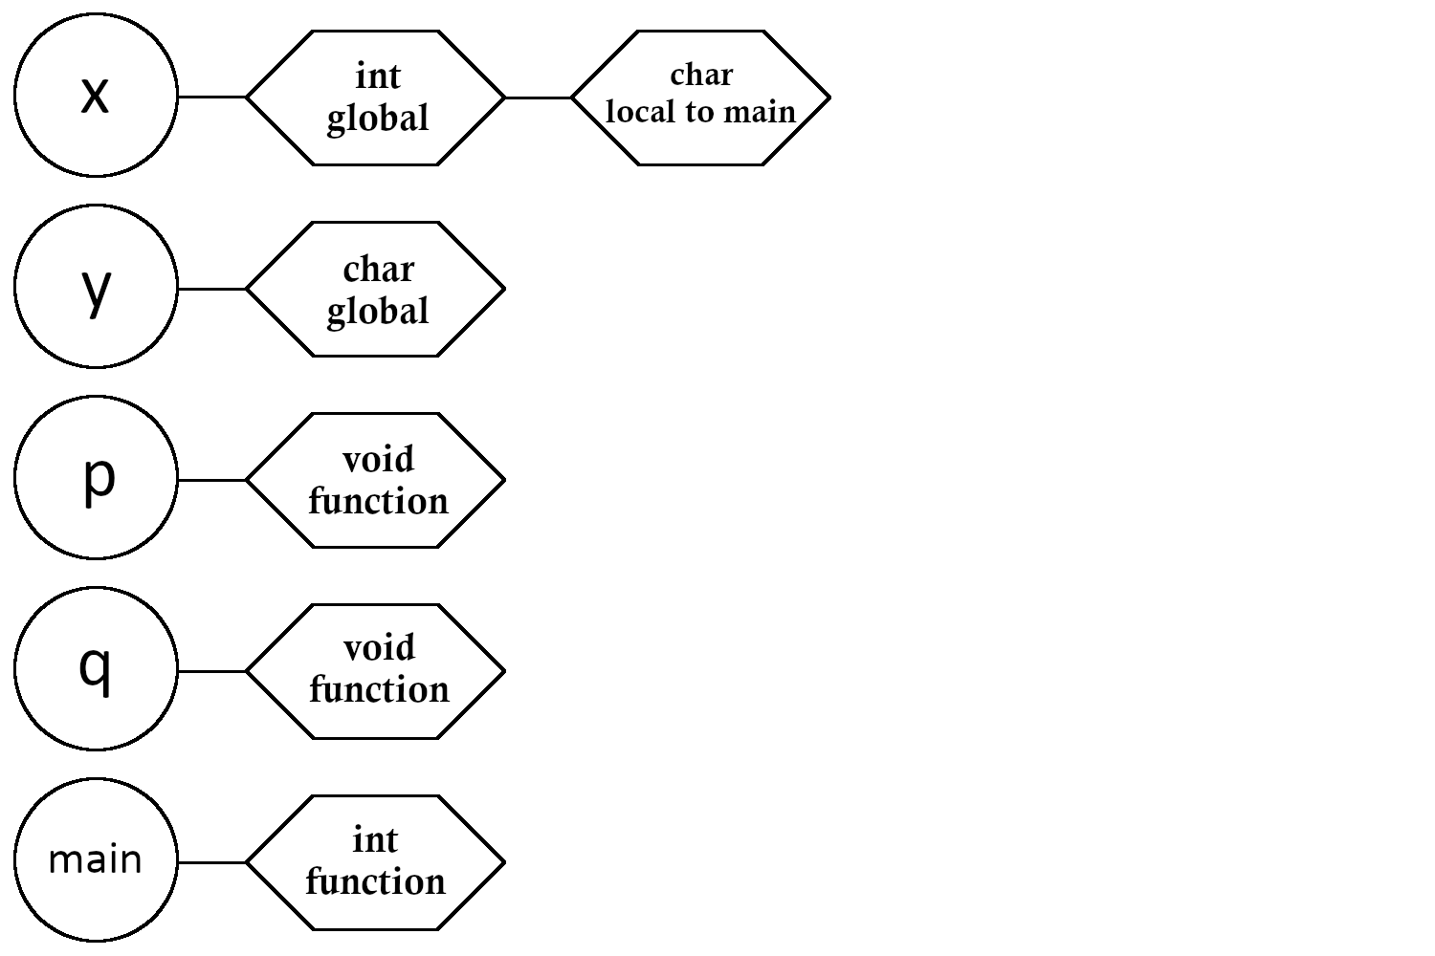
A Statically Scoped Symbol Table

Slide 34
A Statically Scoped Symbol Table

Slide 35
A Statically Scoped Symbol Table

Slide 36
The Symbol Table
There is additional complexity for symbol tables
Example: struct declaration must contain further declarations of the data fields within it
  Those fields must be accessible using dot member notation whenever the struct variable is in scope
  A struct declaration actually contains a local symbol table itself as an attribute
  This local symbol table cannot be deleted until the struct variable itself is deleted from the global symbol table

Slide 37
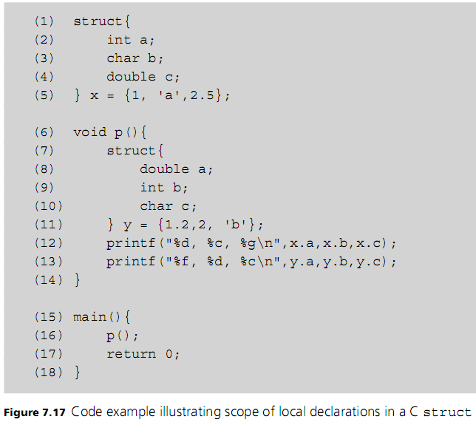
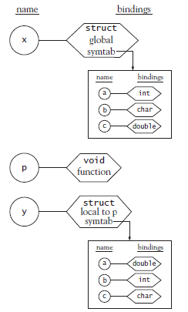

Slide 38
Overloading and Overload Resolution
An important question about declarations and the symbol table is to what extent can the same name be used to reference different things in a program
Example:
  a+b
  Is it:
    operator+(float x, float y)
    operator+(int x, int y)
Name Overloading
  One identifier can mean different things
Notes:
Most programmers don’t worry about the distinction between these two functions—both are based on the same mathematical concept, after all—but they take arguments of different types and perform very different operations on the underlying bits

Slide 39
Overloading and Overload Resolution
Addition operator + actually indicates at least two different operations: integer addition and floating-point addition
  + operator is said to be overloaded
Translator must look at the data type of each operand to determine which operation is needed
Overload resolution: process of choosing a unique function among many with the same name
  In order to support function overloading, lookup operation of a symbol table must use name plus number and data type of arguments
  Number and data type of the arguments is used to disambiguate between overloaded identifiers
Notes:
“Given identifier x and two args of type int, symbol table identifies a unique and unambiguous set of attributes bound to given identifier”

Slide 40
Overloading and Overload Resolution
Many languages allow for function overloading, and some allow for operator overloading
Languages which don’t bind variables to data type attributes can’t support function overloading
  (not without lots of fancy tricks and limitations anyway)
Languages which support optional parameters (such as Python) can’t support function overloading
  When parameters are optional, operands can’t be used as disambiguating information
C doesn’t support function overloading to reduce compiler complexity
  (Ok it’s technically possible in modern standards of C but you need to use a lot of fancy tricks and it’s still really ugly imo)
Notes:
“Languages which don’t bind variables to data type attributes can’t support function overloading” → lol yes dynamically typed languages

Slide 41
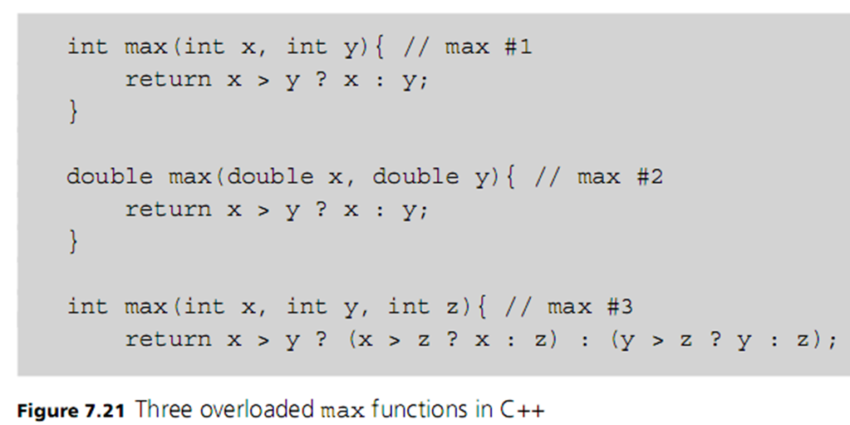

Overloading and Overload Resolution
Notes:
Written in sudocode
C++ illegal – could go both ways, Ada illegal – no automatic conversion, Java – legal
We’ll explain why over the next several slides

Slide 42
Overloading and Overload Resolution
Consider these function calls:
Symbol table can determine the appropriate function based on number and type of parameters – overload resolution
Calling context: the information contained in each call
But this ambiguous call depends on the language rules (if any) for converting between data types:
  Compilation error in C++!
Notes:
So the symbol table can determine the appropriate function based on the calling context
Compilation error in C++: Why? Next slide

Slide 43
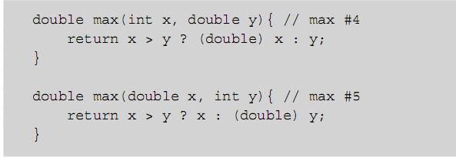
Overloading and Overload Resolution
Adding these definitions makes the function calls legal in C++ but is unnecessary in Java
  In C++ : narrowing primitive conversion must be explicit
Automatic conversions complicate overload resolution

Slide 44
Overloading and Overload Resolution
Additional information in a calling context may be used for overload resolution:
  Ada allows the return type to be used for overload resolution
    a: integer;
    a := max(2,3); // now legal
  C++ and Java ignore the return type
Both Ada and C (but not Java) allow built-in operators to be overloaded
Notes:
Example on next slide

Slide 45
Overloading and Overload Resolution
typedef struct {
int i; double d;
}
IntDouble;
bool operator < (IntDouble x, IntDouble y){
return x.i < y.i && x.d < y.d;
}
IntDouble operator + (IntDouble x, IntDouble y){ IntDouble z;
z.i = x.i + y.i;
z.d = x.d + y.d;
return z;
}

Slide 46
Overloading and Overload Resolution
When overloading a built-in operator, we must accept its syntactic properties
  Example: cannot change the associativity or precedence of the “+” operator
There is no semantic difference between operators and functions, only syntactic difference
  Operators are written in infix form
    a+b is essentially operator+(a,b)
  Function calls are written in prefix form
    GCD(a, b)
Notes:
Unit 2, we have associativity. Can't change the grammar.
It's impossible to change the associativity because the ebnf is set in stone
prefix before, infix middle, postfix after
Symbol tables are a compile time only resource (compiled languages only)
Compile time differentiates which function overload you are calling

Slide 47
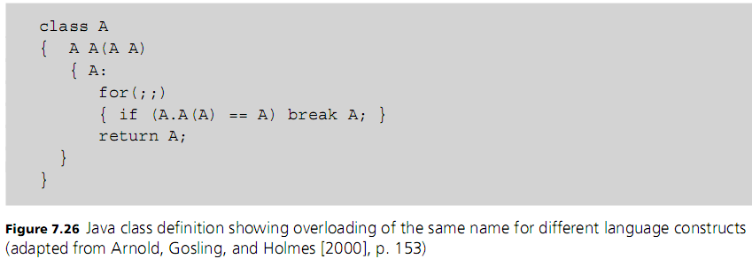
Overloading and Overload Resolution
Some languages use different symbol tables for each of the major kinds of definitions to allow the same name for a type, a function, and a variable
  Example: Java
Notes:
So a function symbol table, variable symbol table, and class (data type) symbol table

Slide 48
Precedence and Associativity
In any given language, evaluation order depends on the precedence and associativity of operators (infix notation)
Issues of precedence and associativity do not arise in prefix or postfix notation
The assumed intent of the language designers was to ensure that “the right thing” will usually happen when parentheses are not used to force a particular evaluation order
Rules for precedence and associativity vary from one language to another

Slide 49
